Slide 2
Mission Objectives
Your instructions go here

Slide 4
Mission Objectives
Your instructions go here

Slide 5
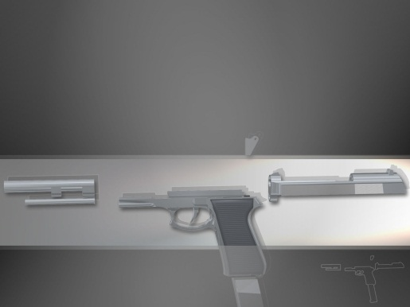
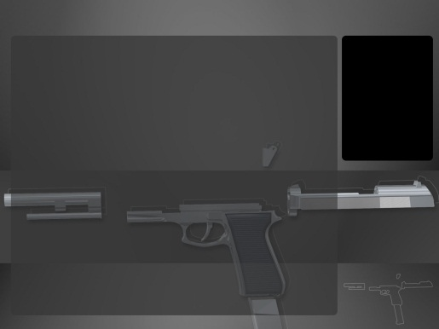
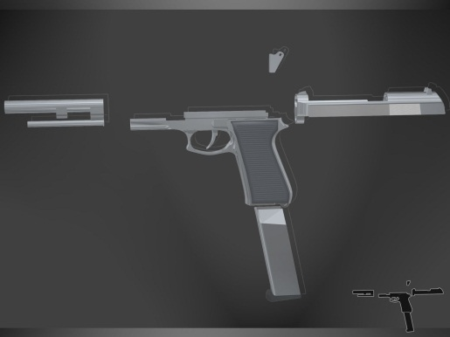
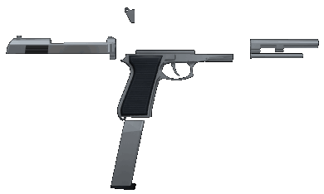
Elements
www.freeppt.net

